Slide 1
Cause of Death

Slide 2
Contents
Problem statement and Objective
Literature Riview
Data Visualization
Conclusion

Slide 3
Problem statement and Objective
A straightforward way to assess the health status of a population is to focus on mortality – or concepts like child mortality or life expectancy, which are based on mortality estimates. A focus on mortality, however, does not take into account that the burden of diseases is not only that they kill people, but that they cause suffering to people who live with them. Assessing health outcomes by both mortality and morbidity (the prevalent diseases) provides a more encompassing view on health outcomes. This is the topic of this entry. The sum of mortality and morbidity is referred to as the ‘burden of disease’ and can be measured by a metric called ‘Disability Adjusted Life Years‘ (DALYs). DALYs are measuring lost health and are a standardized metric that allow for direct comparisons of disease burdens of different diseases across countries, between different populations, and over time. Conceptually, one DALY is the equivalent of losing one year in good health because of either premature death or disease or disability. One DALY represents one lost year of healthy life. The first ‘Global Burden of Disease’ (GBD) was GBD 1990 and the DALY metric was prominently featured in the World Bank’s 1993 World Development Report. Today it is published by both the researchers at the Institute of Health Metrics and Evaluation (IHME) and the ‘Disease Burden Unit’ at the World Health Organization (WHO), which was created in 1998. The IHME continues the work that was started in the early 1990s and publishes the Global Burden of Disease study.

Slide 4
Literature Review
So, In this datset we have 34 Columns and 6120 Rows and 2 Columns in Object Datatype and left all are integer and in this dataset Our Object Columns is a Country name and left all are integer type which shows the disease name and the total Mortality by the Disease . And data comes from 30 years from 1989 to 2019
Columns Name -> Country/Territory, Code, Year, Meningitis,Alzheimer's Disease and Other Dementias, Parkinson's Disease,Nutritional Deficiencies,Malaria, Drowning,Interpersonal Violence,Maternal Disorders,HIV/AIDS,Drug Use Disorders,Tuberculosis,Cardiovascular Diseases,Lower Respiratory Infections,Neonatal Disorders,Alcohol Use Disorders,Self-harm,Exposure to Forces of Nature,Diarrheal Diseases,Environmental Heat and Cold Exposure,Neoplasms,Conflict and Terrorism,Diabetes Mellitus,Chronic Kidney Disease,Poisonings,Protein-Energy Malnutrition,Road Injuries,Chronic Respiratory Diseases,Cirrhosis and Other Chronic Liver Diseases,Digestive Diseas,Fire, Heat, and Hot Substances, Acute Hepatitis

Slide 5
Analytical Problem Framing
In this dataset we have to find the mortality as per country and the chances of causes of death with disease . We have list of disease name columns and in column we have the total number of death by disease . The sum of mortality and morbidity is referred to as the ‘burden of disease’ and can be measured by a metric called ‘Disability Adjusted Life Years‘ (DALYs). And we have to predict the Cause of death Datset . In this dataset we have 2 Object column and left all are integer columns.

Slide 6
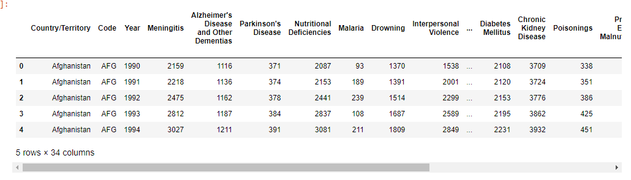
EDA -> Exploratory Data Analysis
There are 6120 Rows and 34 Columns
There are no Missing Values in the Dataset
There are 2 Object Data Type Column 32 Integer Columns

Slide 7
Lets Check Mortality Disease By Country

Slide 8
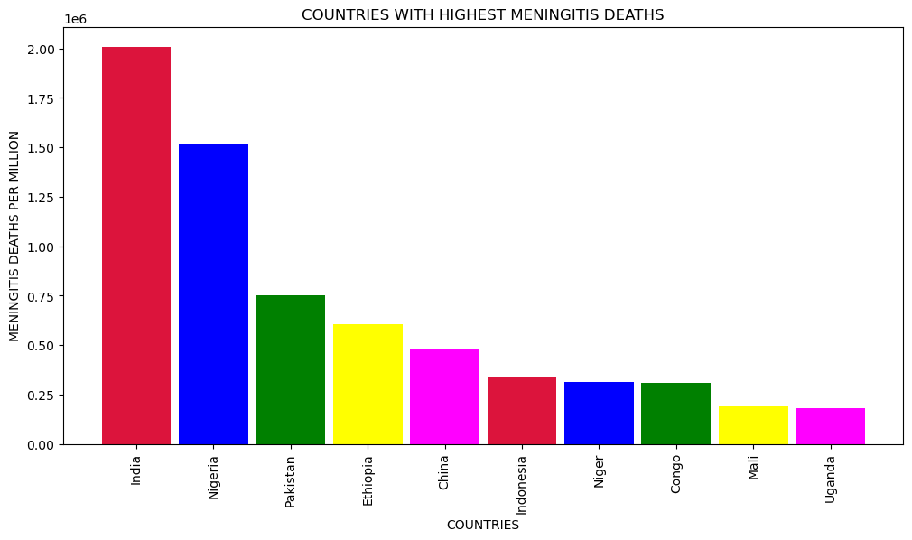
Countries With Highest Meningitis Death

Slide 9
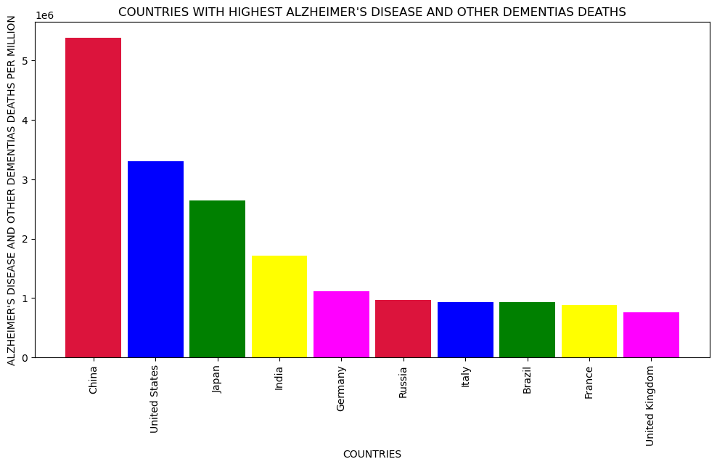
Countries with Highest Alzheimer's Disease and Other Dementias Death

Slide 10
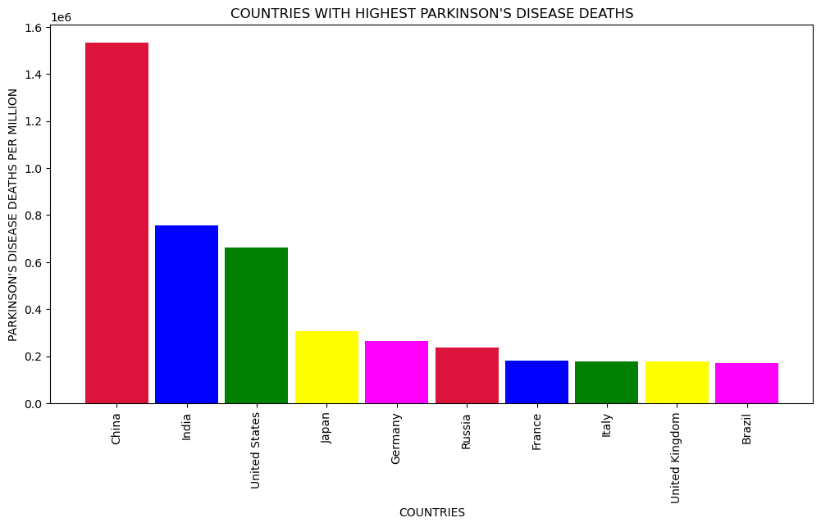
Countries with Highest Parkinson's Disease Death

Slide 11
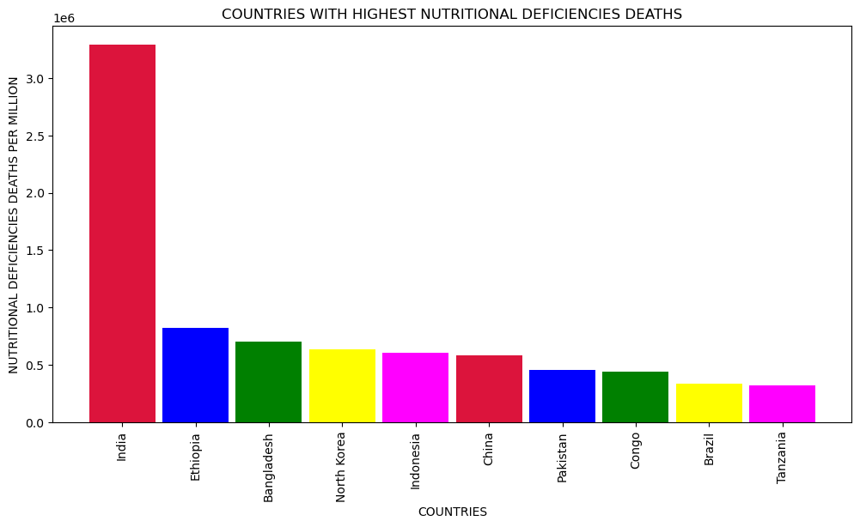
Countries with Highest Nutritional Deficiencies Death

Slide 12
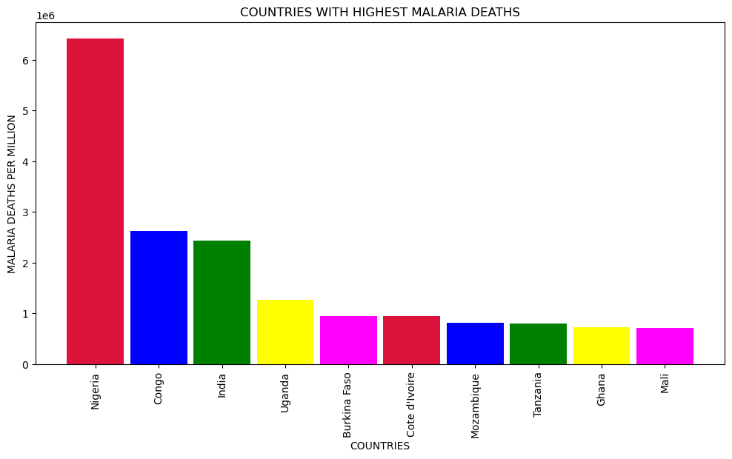
Countries with Highest Malaria Death

Slide 13
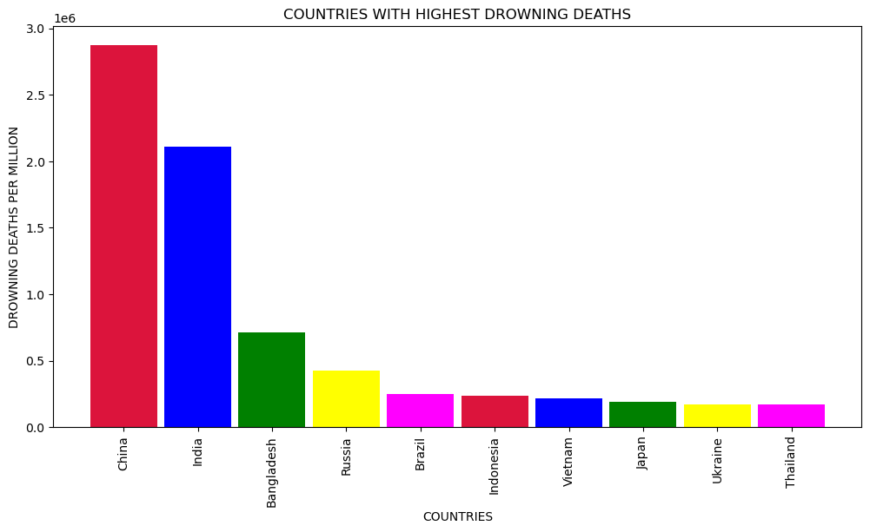
Countries with Highest Drowning Death

Slide 14
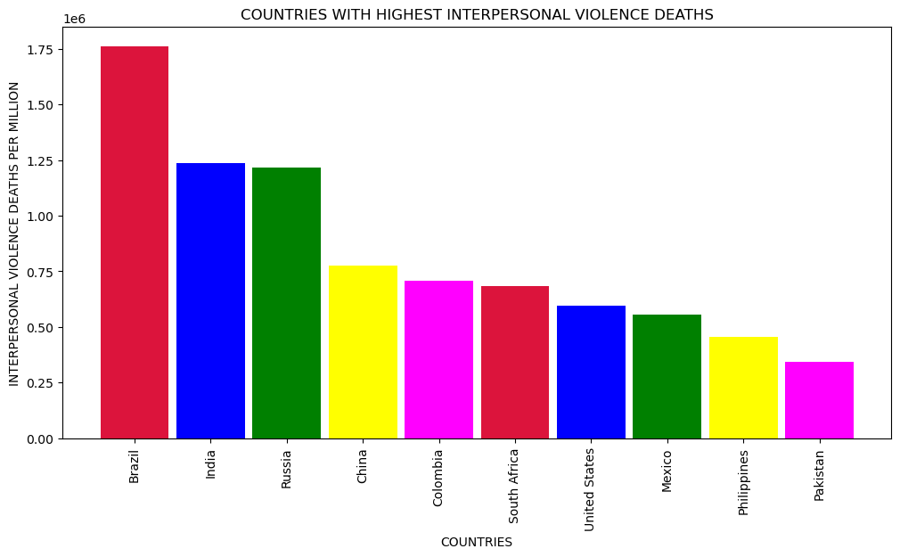
Countries with Highest Interpersonal Violence Death

Slide 15
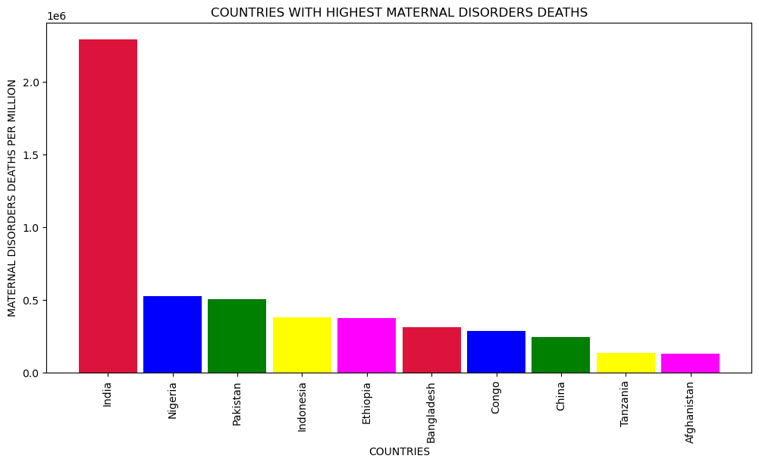
Countries with Highest Maternal Disorders Death

Slide 16
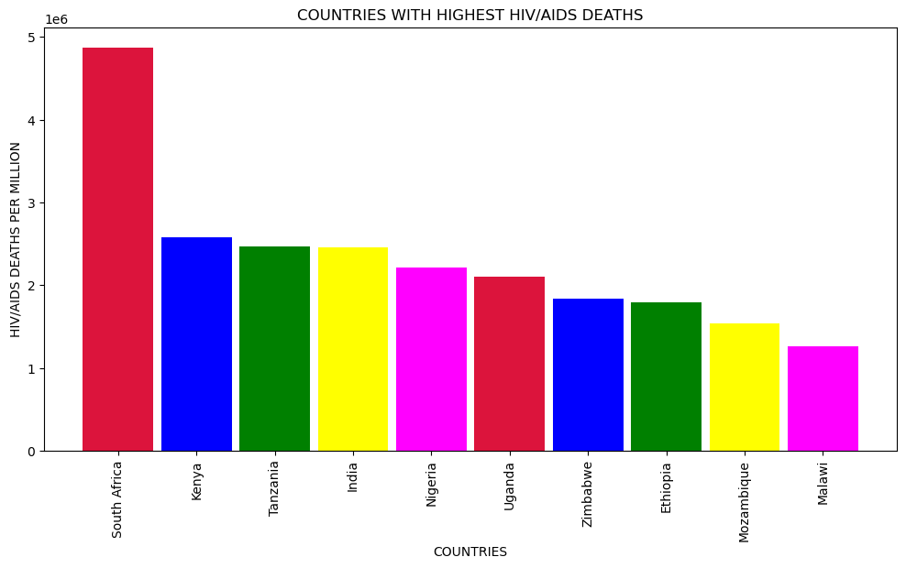
Countries with Highest HIV/AIDS Death

Slide 17
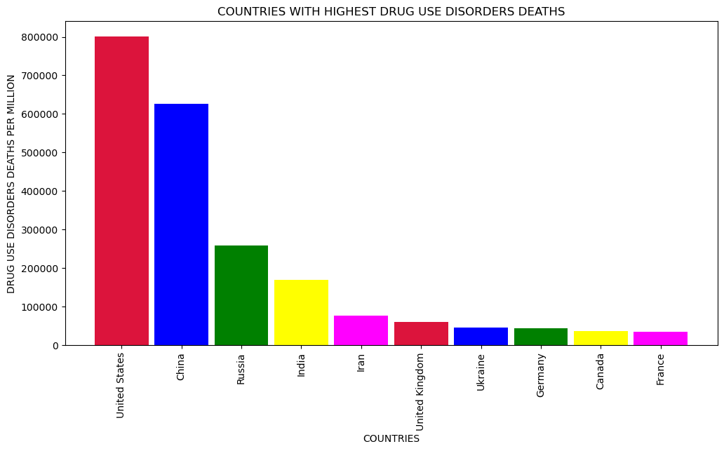
Countries with Highest Drug Use Disorders Death

Slide 18
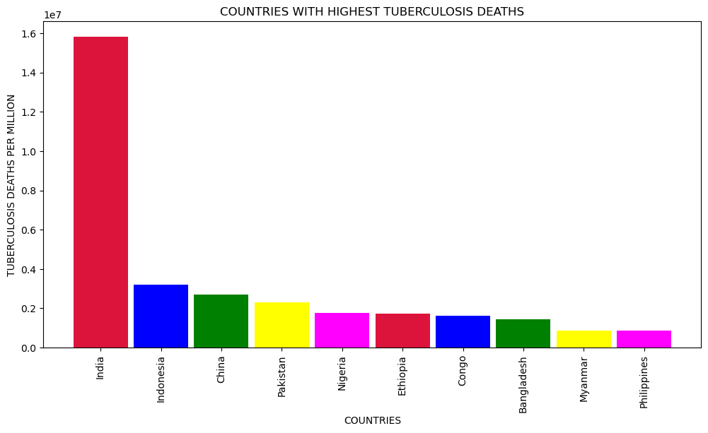
Countries with Highest Tuberculosis Death

Slide 19
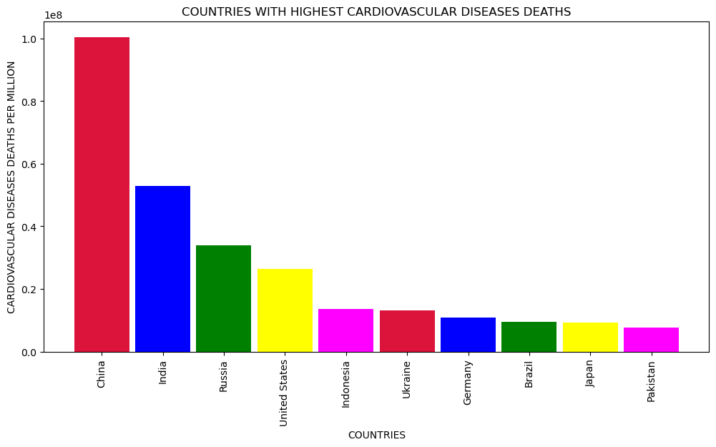
Countries with Highest Cardiovascular Diseases Death

Slide 20
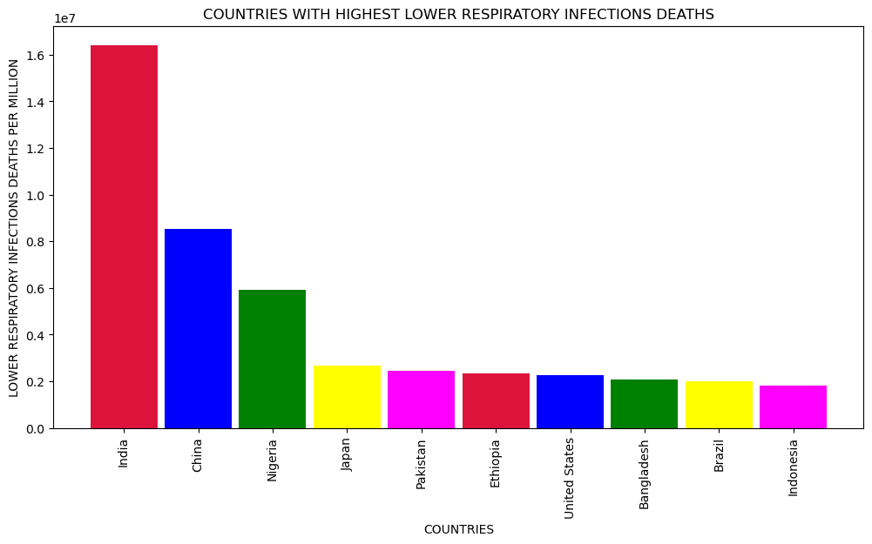
Countries with Highest Lower Respiratory Infections Death

Slide 21
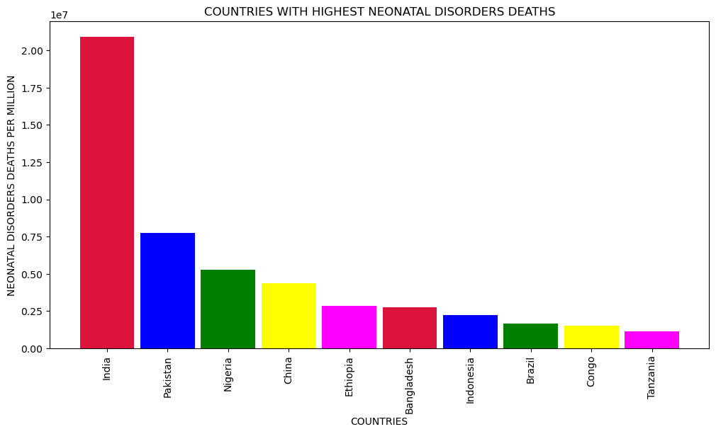
Countries with Highest Neonatal Disorders Death

Slide 22
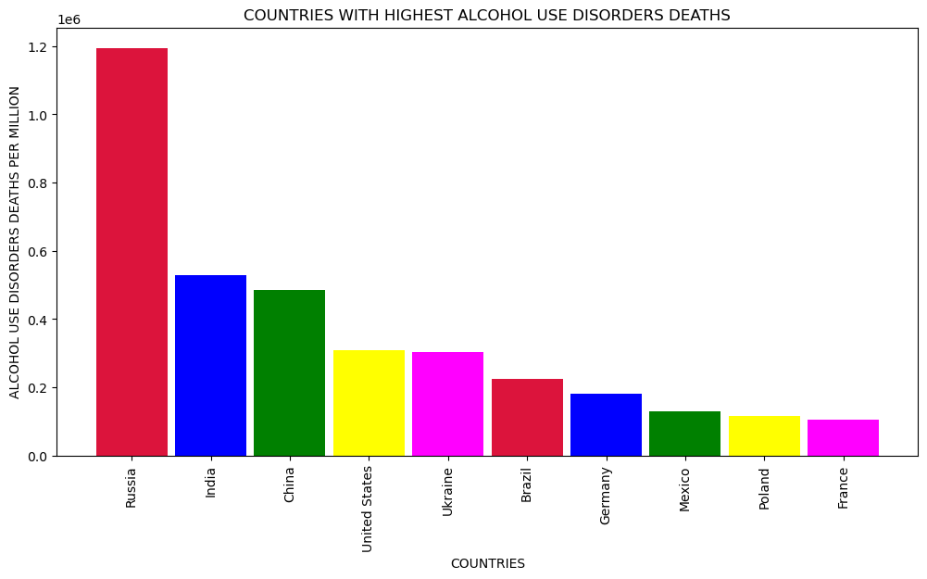
Countries with Highest Alcohol Use Disorders Death

Slide 23
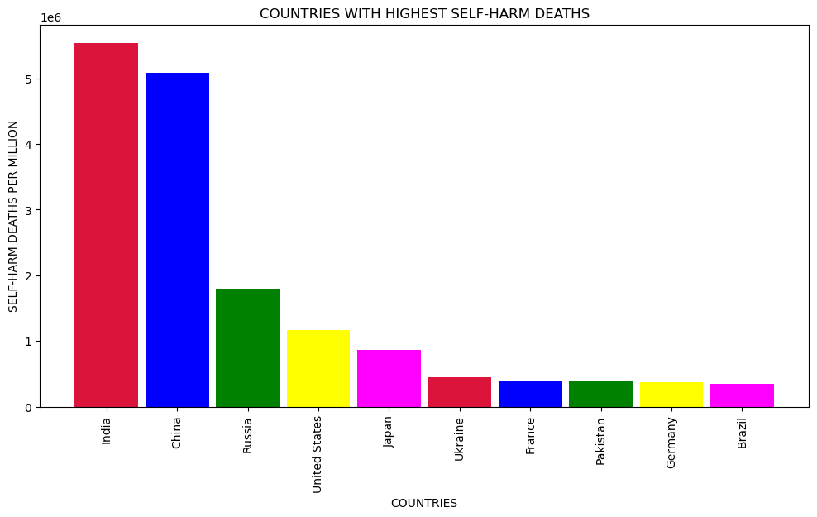
Countries with Highest Self-harm Death

Slide 24
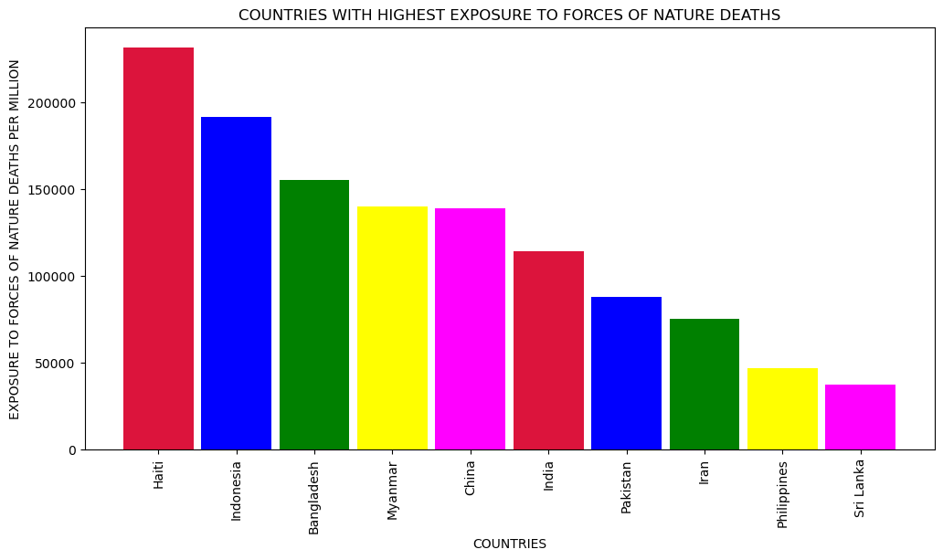
Countries with Highest Exposure to Forces of Nature Death

Slide 25
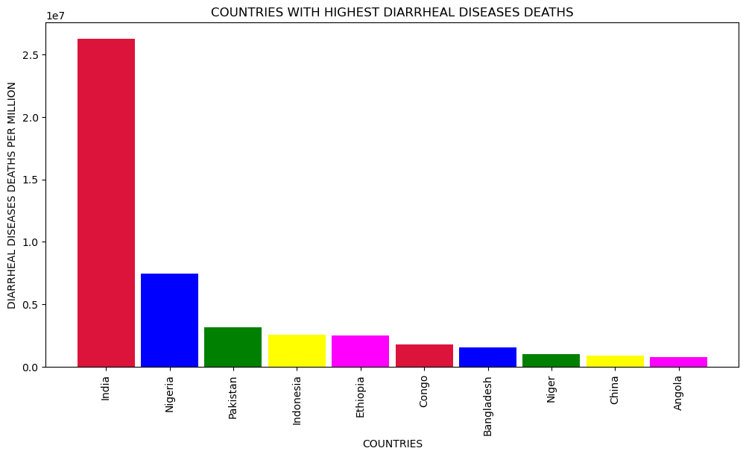
Countries with Highest Diarrheal Diseases Death

Slide 26
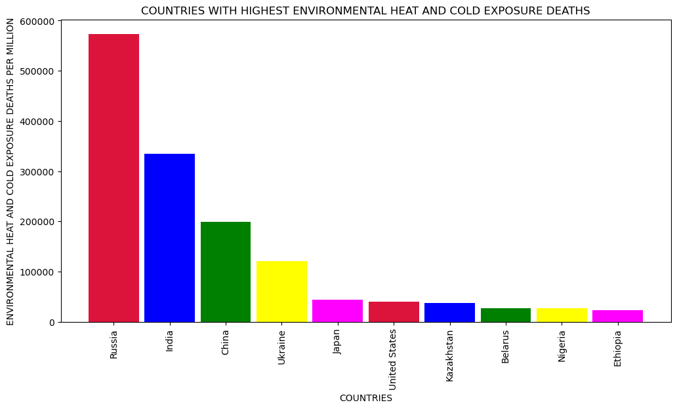
Countries with Highest Environmental Heat and Cold Exposure Death

Slide 27
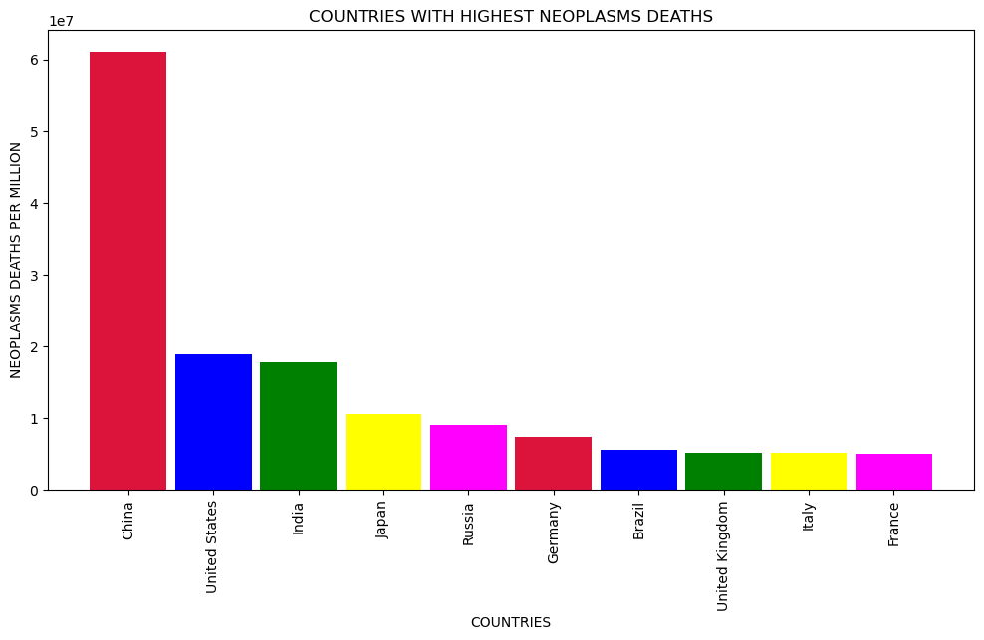
Countries with Highest Neoplasms Death

Slide 28
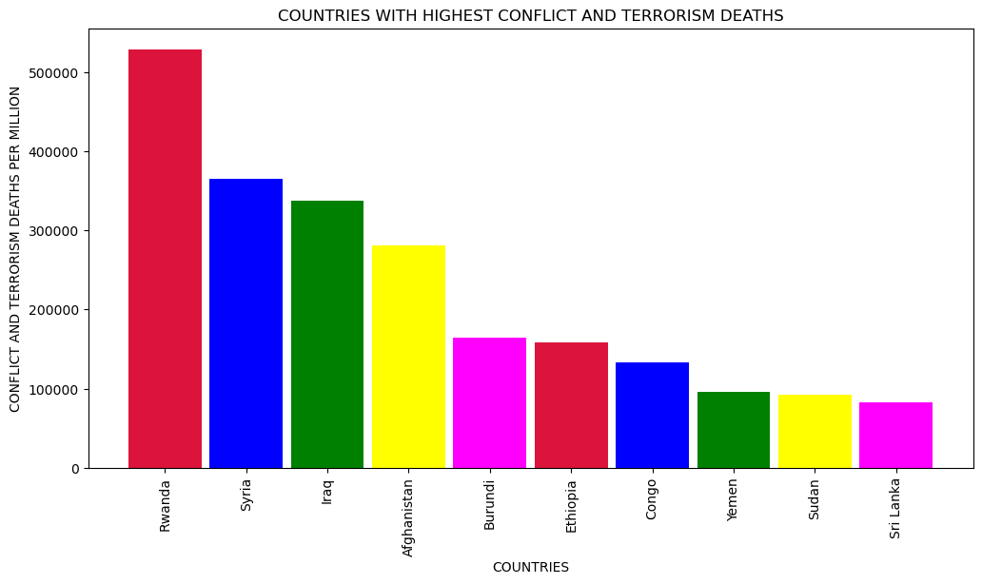
Countries with Highest Conflict and Terrorism Death

Slide 29
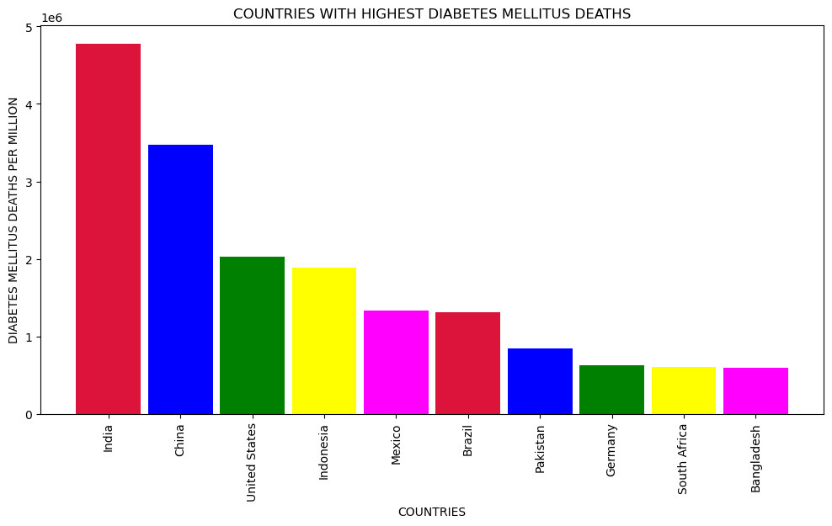
Countries with Highest Diabetes Mellitus Death

Slide 30
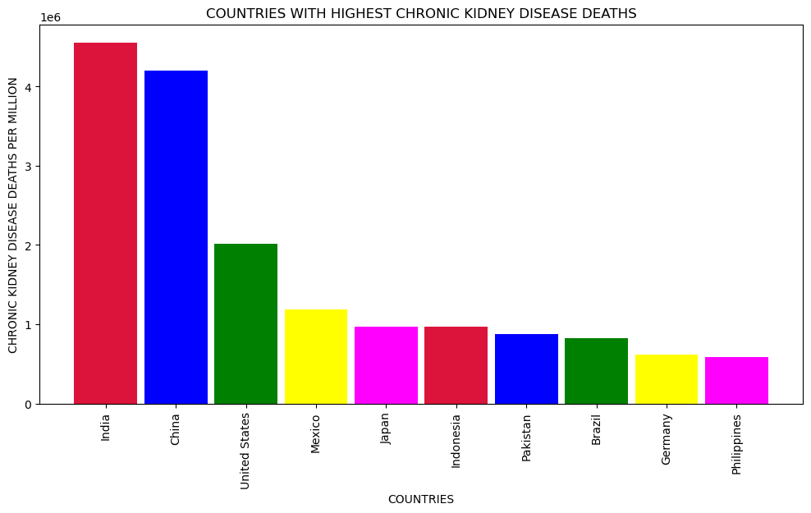
Countries with Highest Chronic Kidney Disease Death

Slide 31
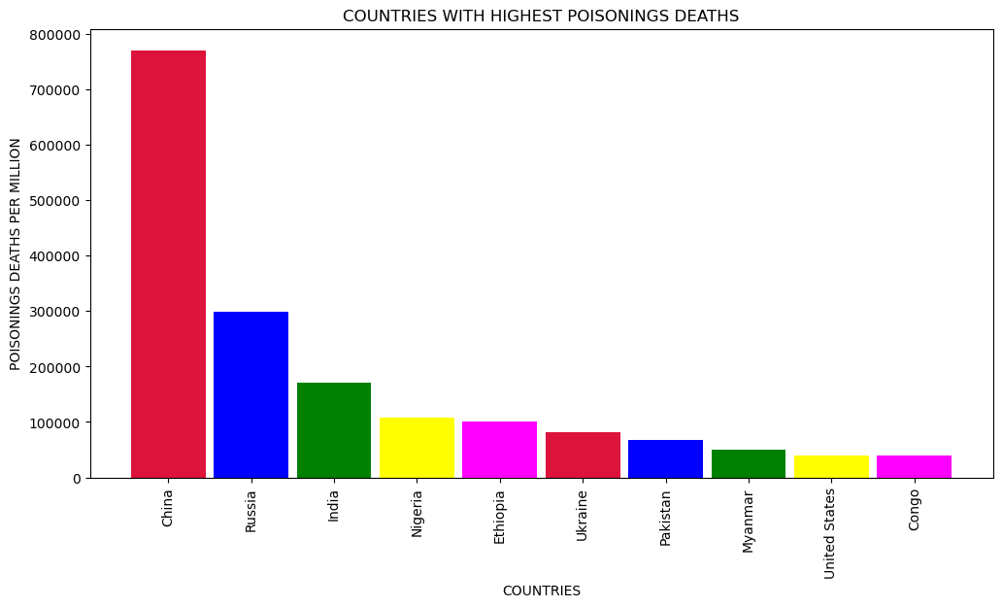
Countries with Highest Poisonings Disease Death

Slide 32
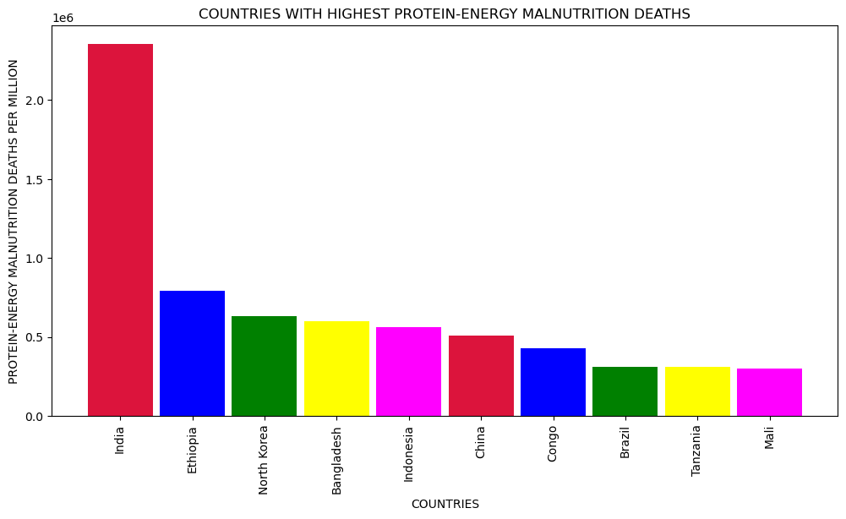
Countries with Highest Protein-Energy Malnutrition Death

Slide 33
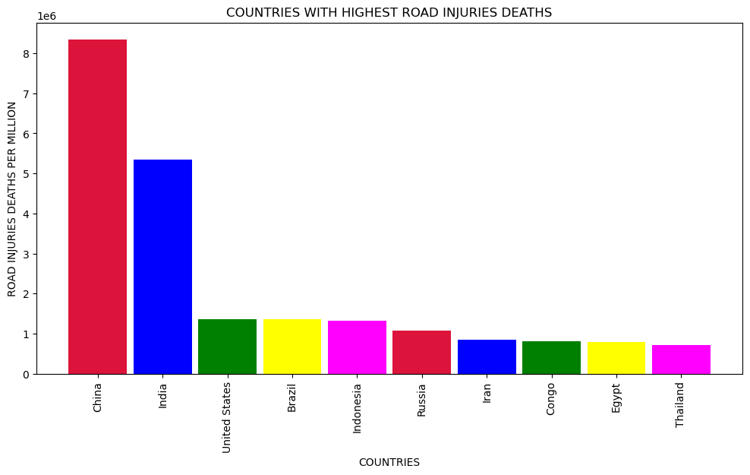
Countries with Highest Road Injuries Death

Slide 34
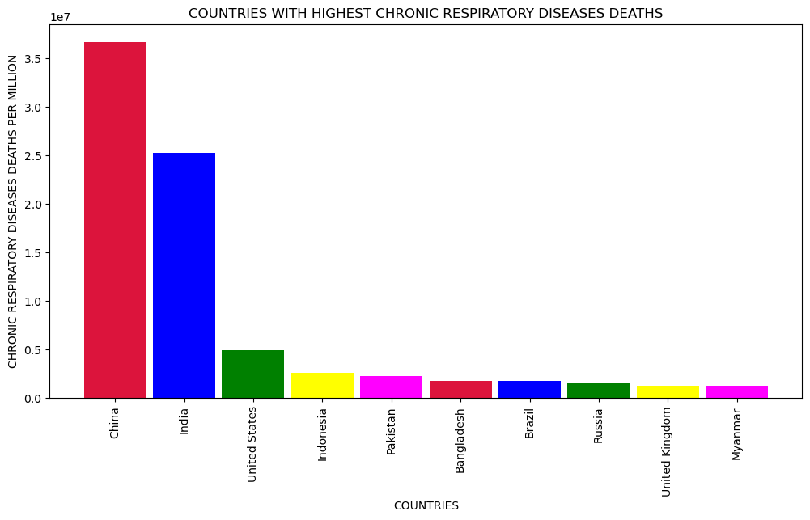
Countries with Chronic Respiratory Diseases Death

Slide 35
Countries with Cirrhosis and Other Chronic Liver Diseases Death

Slide 36
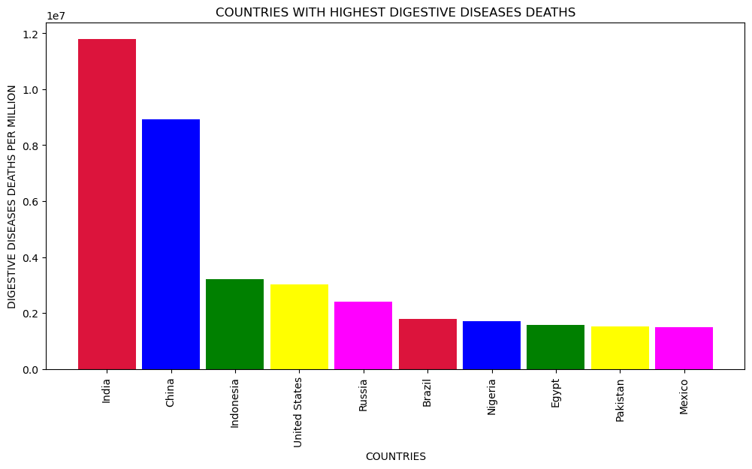
Countries with Digestive Diseases Death

Slide 37
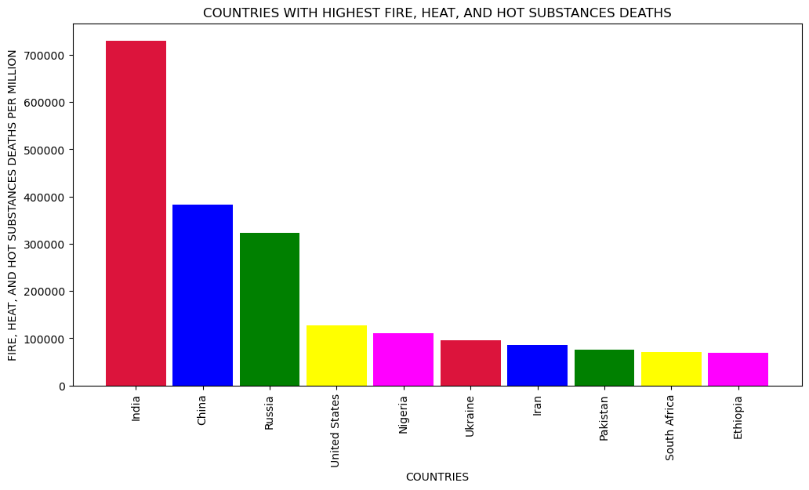
Countries with Fire, Heat, and Hot Substances Death

Slide 38
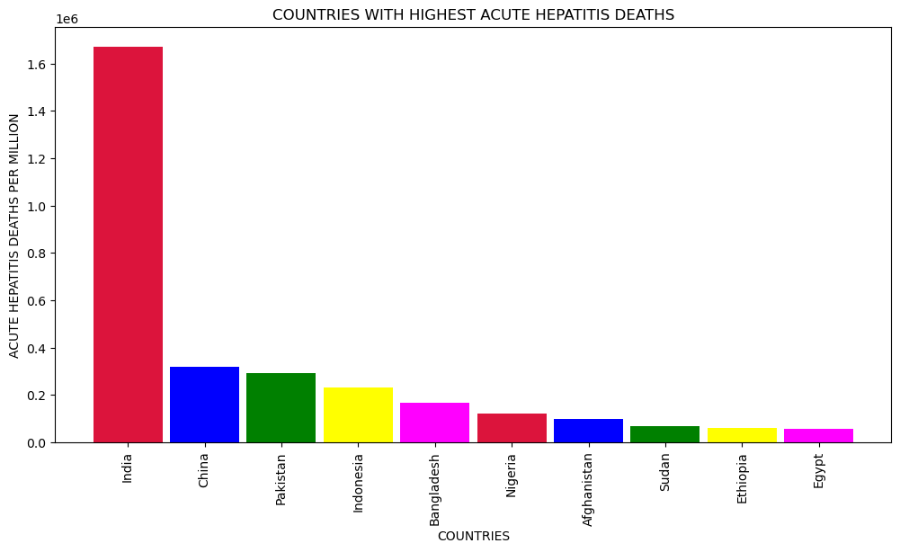
Countries with Acute Hepatitis Death

Slide 39
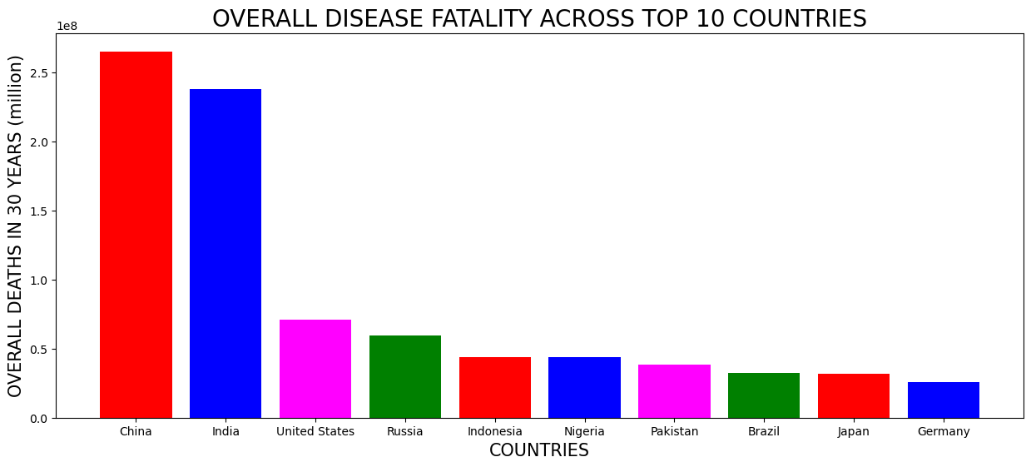
WHICH ARE THE COUNTRIES FACING OVERALL HIGHEST DEATHS DUE TO DISEASES –

Slide 40
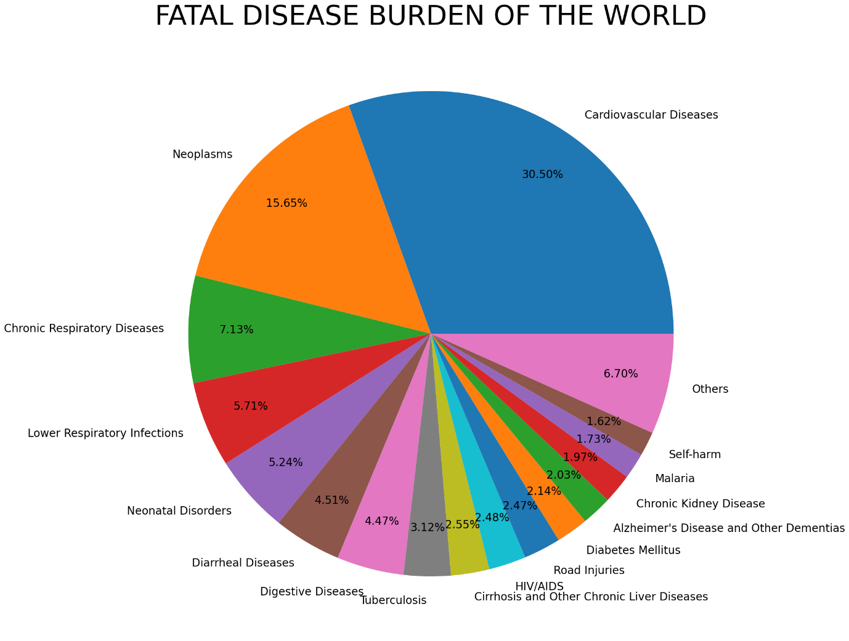
WHICH ARE THE TOP KILLER DISEASES IN THE WORLD

Slide 41
Conclusion
As according to dataset CHINA , INDIA AND USA face the largest brunt of deaths due to diseases in the world Cardiovascular diseases , Neoplasms (Malignancy/Cancer) and Lower Respiratory Tract Infections (for example : Pneumonia) are the top 3 killer diseases in the world. Overall Deaths in 30 Years. And left disease are also cause of death but not more the the Cardiovascular diseases, Neoplasms (Malignancy/Cancer) and Lower Respiratory Tract Infections (for example : Pneumonia.
This is observation of me from Given Datset.

Slide 42
Thankyou

